Slide 1


Innovative solution for agriculture and education by use of cloud, ICT and Mass Media for attaining SDG2030
By
WDF University for SDG2030

Slide 2
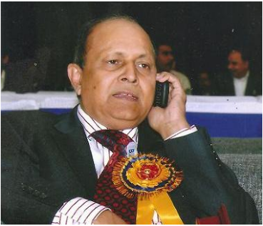
Prof. H. O. Srivastava
M.Sc., M.Phil. Ph.D. (Info. Systems), Ph.D.(Chemistry), D. Lit.
WDF University for SDG2030
& Former Addl. Director General AIR & DD

Slide 3
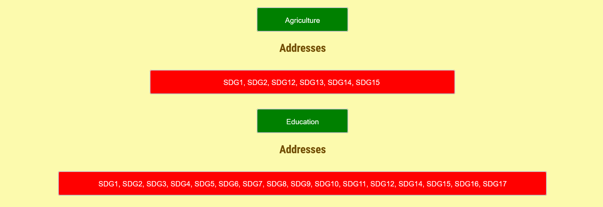
Scenario
SDG2030 (2015)
17 global goals designed to be a “blueprint to achieve a better and more sustainable future for all”

Slide 4
Scenario-2
In 2017, Prime Minister of India, set up a Goal of doubling the income of farmers by 2022.
Global hunger rate is increasing in last 4 years.
8.8 million children below 5 years died of malnutrition in 2018 in India (Highest on Globe).
Our agriculture growth is not enough to attain the 2022 goal
Almost all the problems arise due to about 50% of the world population useing primitive style of farming.

Slide 5
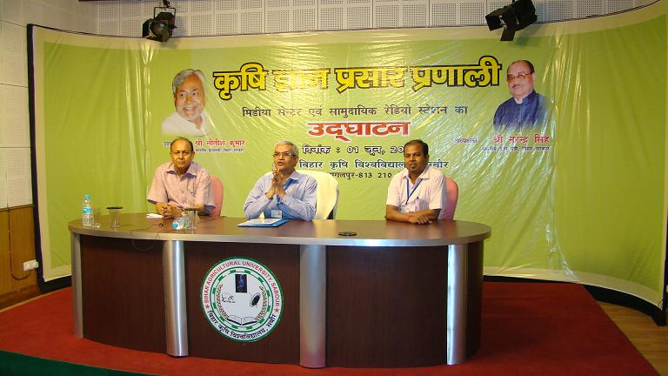
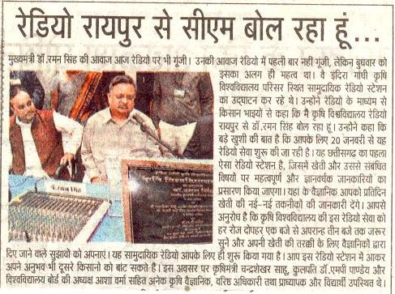
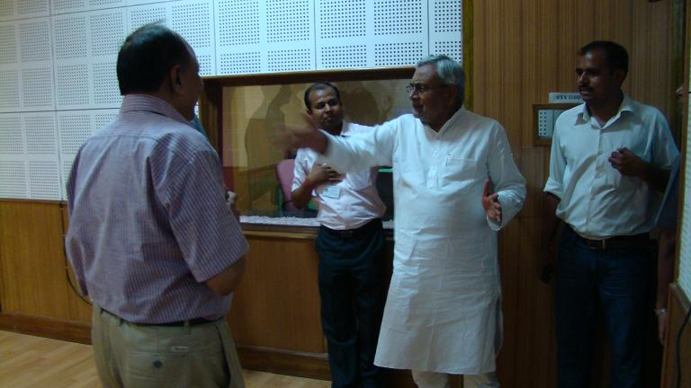
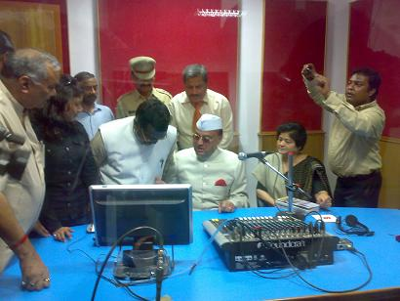
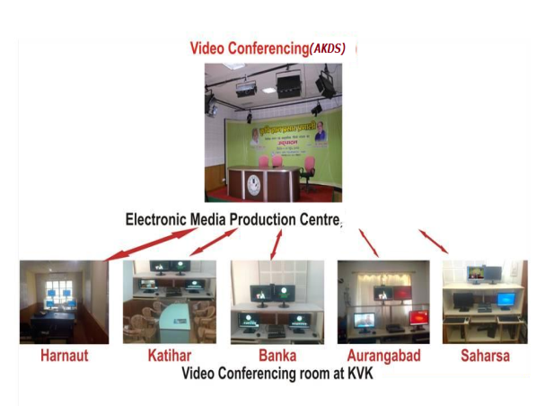
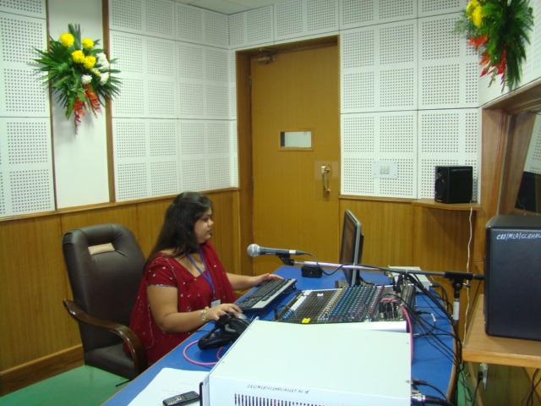
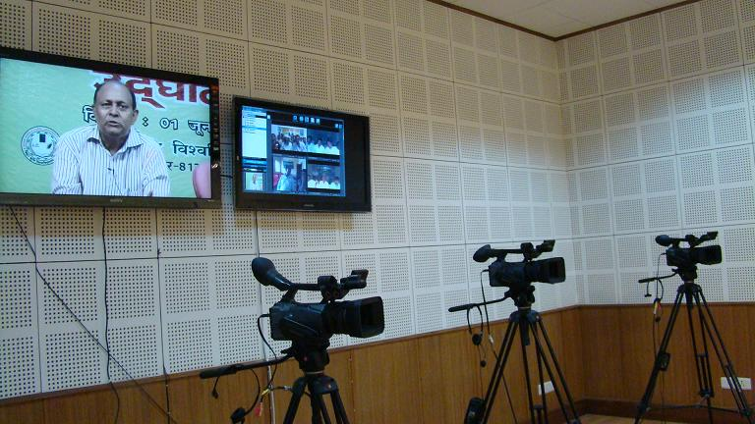
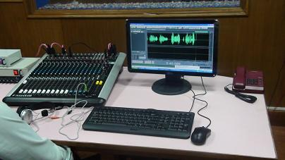
Solutions-
New tools & technology: ICT, mass media, cloud, AI in Agriculture & education
IGKV, Raipur
(Multi Purpose Studio) built
Narendra Deva Radio
Station
H.E. Governor,
Jharkhand: Ranchi Univ
AKDS Bihar

Slide 6
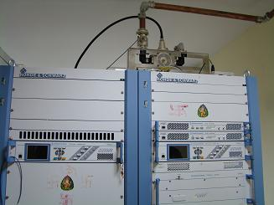
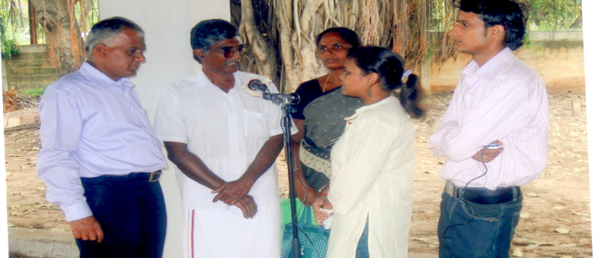
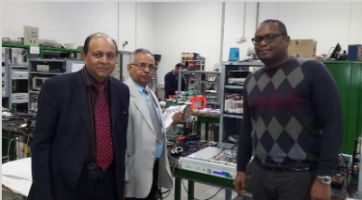
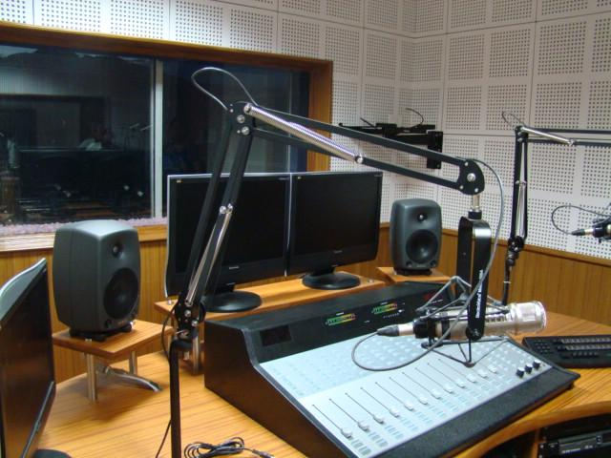
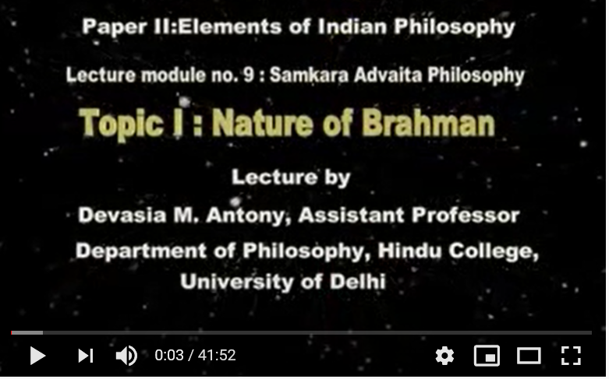
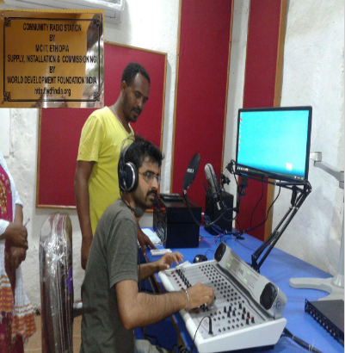
National /International Projects Implemented
Commercial FM
Recording in field at TNAU
CRS at Ethiopia

Slide 7
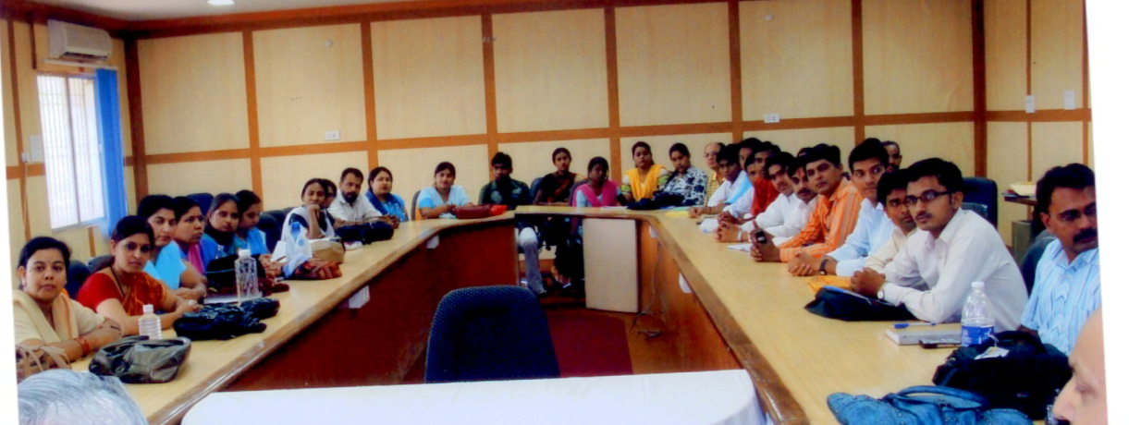
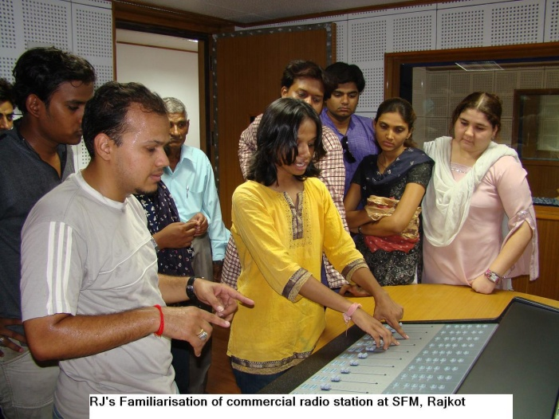
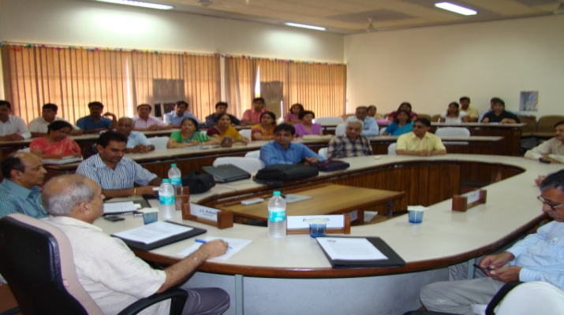
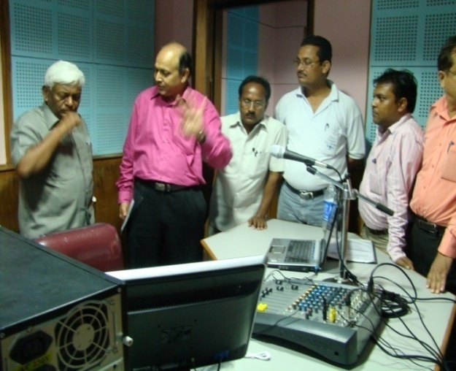
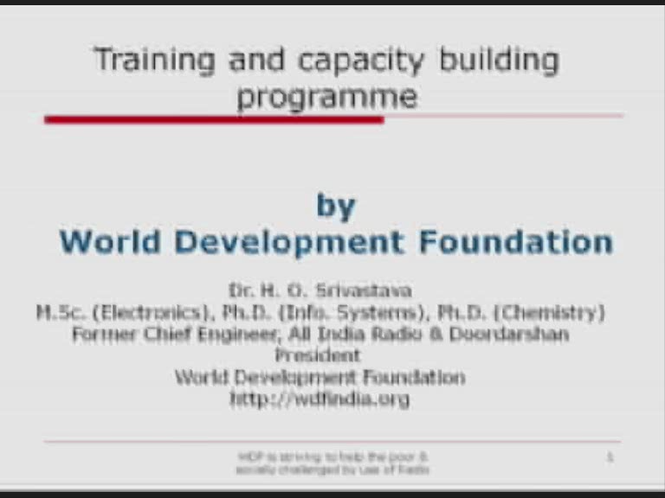
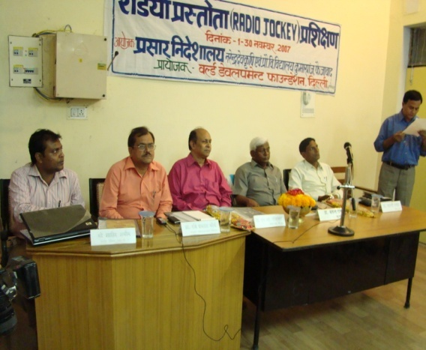
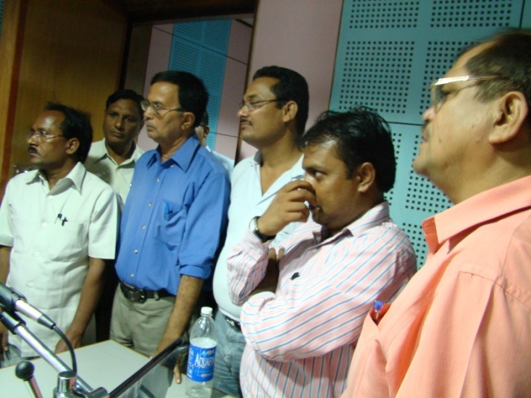
Training /courses conducted

Slide 8
Collaborators & Clients
Media Lab Asia, Min of IT
Narendra Deva University A&T, Faizabad
Birsa Agriculture Univ., Ranchi
Indira Gandhi Krishi Vishwavidyala, Raipur
Tamil Nadu Agriculture University
Allahabad Agriculture University
Hissar Agriculture University, Haryana
Shobhit Deemed University,
MGAHV Wardha – EMPC, e-learning, Shakshat -NMEICT
Kal Radio, Kochi Sun FM Ahmedabad, Rajkot, Siliguri, Gangtok -, Khatpad, Nepal Commercial
TERI, Ghazipur- Hon. Director and Member Governing council
RAU, BAU Bihar &All KVKs in BIHAR, all KVKs in UP & Others

Slide 9

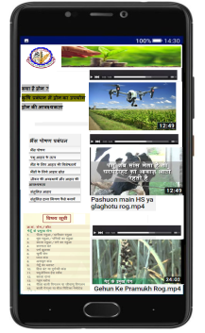
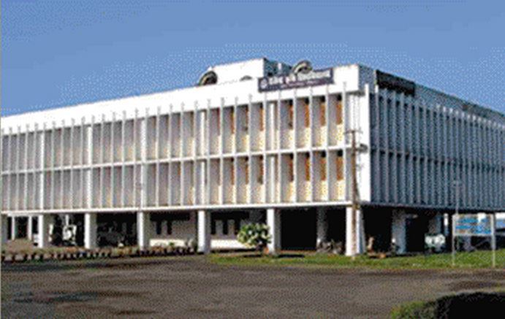
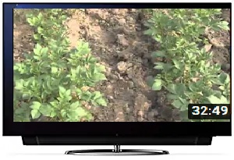

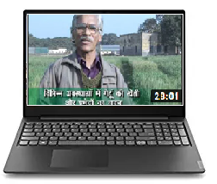
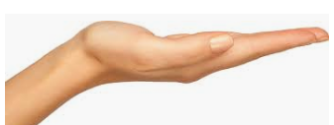
Solution
LMS HOST
Digital Receiving
Devices
KVK 1
University
KVK2
KVK 16
Servers in LMS LAB
University shall be provided with a LMS Lab with server, production and editing facility with Hosting on remote server
All KVKs shall be provided LEDD screens and PCs for showing webinars/ videos in one of existing hall/room
University, All KVKs, farmers, students, associates, colleges, provided access through password, anywhere in the world

Slide 10





National Cloud
KVK 1
Digital Receiving
Devices
Broadband Connectivity
Cloud connectivity
KVK2
University Cloud
Broadband Connectivity
Cloud connectivity
KVK 3
Broadband Connectivity
Cloud connectivity
Intelligence base
Intelligent Based
Notation
Cloud connectivity
National Cloud
University Cloud
Local Clouds

Slide 11
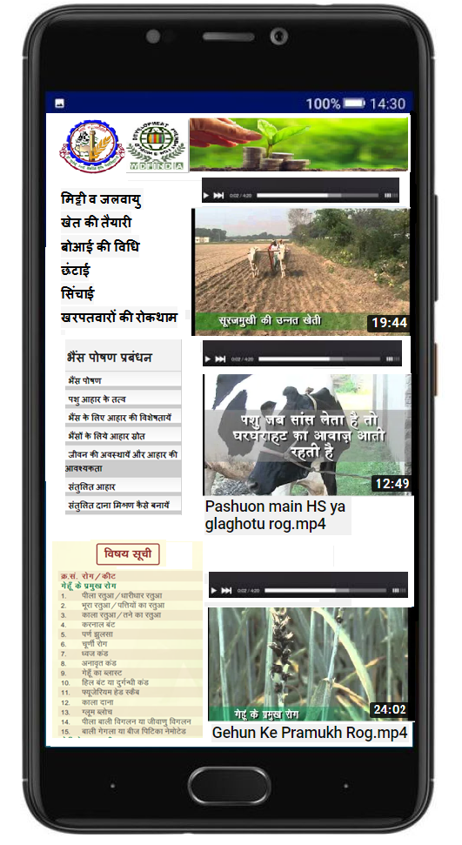
Technology
Cloud based connectivity system
Online video conferencing with kvks
Limited e-marketing to start with
Agriculture Knowledge-Base
Learning Management System (LMS), MOOCs
Google play app for receiving message on mobile
Instant connectivity with all KVKs, farmers of Bihar having mobile phone

Slide 12
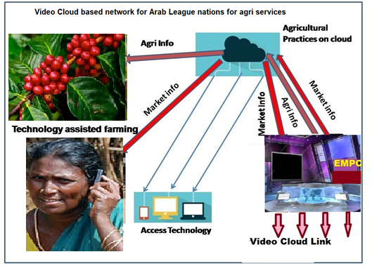
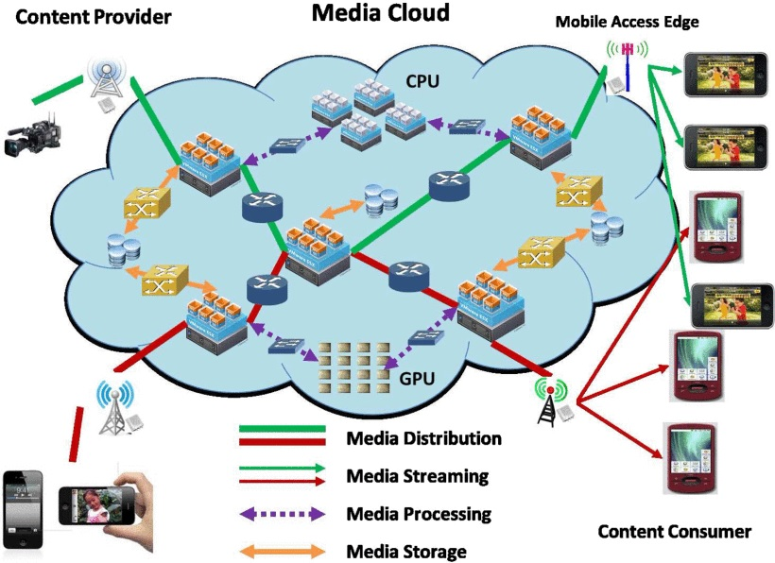
Future

Slide 13
Thank You!
For further details
Please contact: email: wdfindia@yahoo.co.in
drhosrivastava@gmail.com
Phone No: 011-45701632, + 91 9810523668
http://www.worlddevelopmentfoundation.in/
http://wdfuniversity.org
http://wdfindia.org
http://www.youtube.com/user/wdfindia/videos

